Slide 1

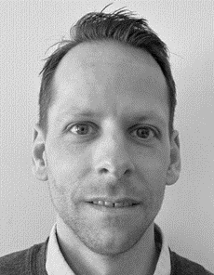


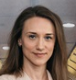
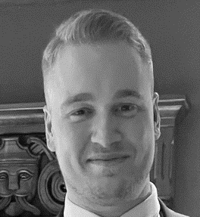
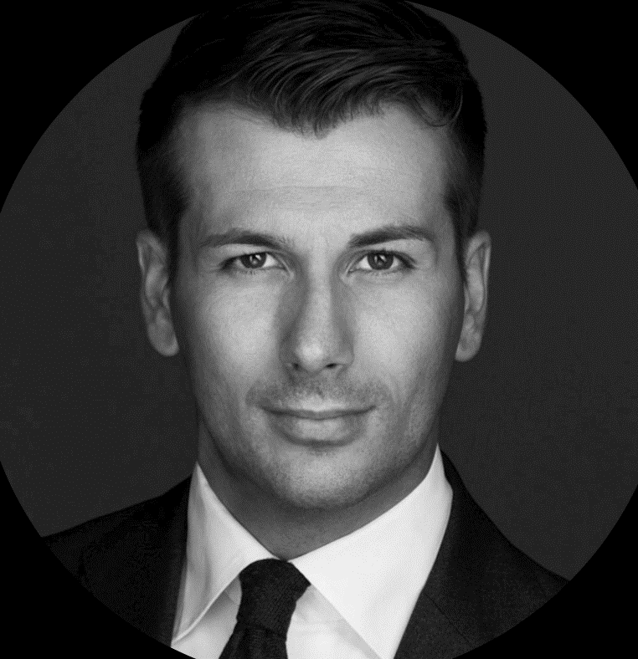

Your DHL Express team
Customer Service
Frontline Desk
Tracking, customs, booking, MyDHL+
E-mail: no.cs@dhl.com
Phone: +47 21 00 22 00
Kasper Kristiansen
Same Day & Special Services
Time critical / special solutions
E-mail: specialservices.no@dhl.com
Phone: +47 468 61 818
Madelén Enger
Field Sales Executive
Commercial responsible
E-mail: Madelen.enger@dhl.com
Phone: +47 918 19 603
Cecilie Fosshaug
Indoor Sales Executive
Support, statistics, reports
E-mail: norway.support@dhl.com Phone: +47 669 72 402
Christian Gundersen
Electronical Solutions Specialist
IT & integrations
E-mail: essno@dhl.com
Phone: +47 21 00 22 00 #3
Roni Beckovic
Sales Manager Norway
Escalations and sponsor
E-mail: roni.beckovic@dhl.com
Phone: +47 415 25 982

Slide 2


KUNDESERVICE
Tilgjengelige mellom kl 08:00-16:00.
1st CONTACT
Customer Service
Frontline Desk
Tlf, 2100 2200
#1 – Booking / Price queries
#2 – Tracking / Delivery information
#3 – Electronic Shipping Solution / MyDHL+
#4 – Invoice
#5 – Customs clearance
#6 – Other questions
Email: no.cs@dhl.com
Import/fortolling: norwayimport@dhl.com
ESS: essno@dhl.com Farlig gods: no.dg@dhl.com
RELIABLITY AND CUSTOMER FOCUS IS IN OUR DNA

